Slide 1

ALGORITMO DE FORD-FULKERSON
Estructuras de Datos y Análisis de Algoritmos
Brayan Rodolfo Barajas Ochoa
Kevin Javier Lozano Galvis
Juan Camilo Londoño Jaimes
María Angélica Serrano Mora

Slide 2
8
10
20
2
10
0
20
3
10
4
10
30
10
30
20
0
20
30
9
1
30
10
5
20
6
20
30
0
30
10
50
0
Origen
7
Destino

Slide 3
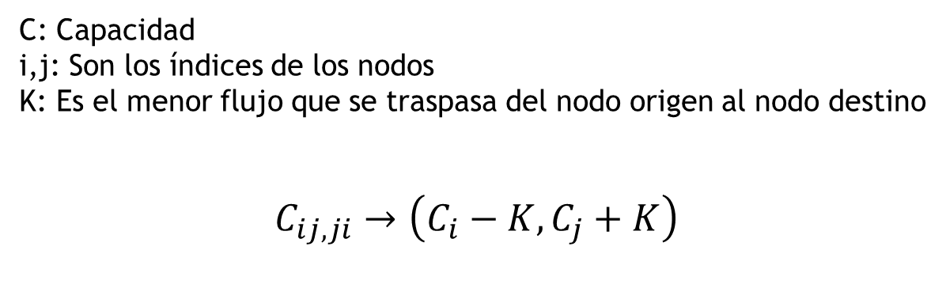
Como determinar el Flujo Máximo
C: Capacidad
i,j: Son los índices de los nodos
K: Es el menor flujo que se traspasa del nodo origen al nodo destino
$$C_{ij,ji}→\left(C_{i}−K,C_{j}+K\right)$$

Slide 4
8
20
10
2
0
10
30
3
20
4
30
20
0
0
0
30
9
1
20
30
0
0
5
50
6
50
0
10
0
40
20
30
Origen
7
Destino

Slide 5
¿Cómo lo representamos?
Grafo Representado por Matriz de Adyacencia
 | 1 | 2 | 3 | 4 | 5 | 6 | 7 | 8 | 9
1 | 0 | 20 | 0 | 0 | 30 | 0 | 30 | 0 | 0
2 | 10 | 0 | 30 | 0 | 0 | 0 | 0 | 20 | 0
3 | 0 | 20 | 0 | 10 | 0 | 0 | 0 | 0 | 0
4 | 0 | 0 | 10 | 0 | 0 | 20 | 0 | 0 | 30
5 | 20 | 0 | 0 | 0 | 0 | 30 | 0 | 0 | 0
6 | 0 | 0 | 0 | 30 | 20 | 0 | 0 | 0 | 10
7 | 10 | 0 | 0 | 0 | 0 | 0 | 0 | 0 | 50
8 | 0 | 10 | 0 | 0 | 0 | 0 | 0 | 0 | 10
9 | 0 | 0 | 0 | 0 | 0 | 0 | 0 | 0 | 0

Slide 6
PRUEBA DE ESCRITORIO
Iteración 1:
Parent[ ]
1 | 2 | 3 | 4 | 5 | 6 | 7 | 8 | 9
0 | 1 | 2 | 3 | 1 | 5 | 1 | 2 | 7
Grafo Residual[ ]
Path_Flow=30
 | 1 | 2 | 3 | 4 | 5 | 6 | 7 | 8 | 9
1 | 0 | 20 | 0 | 0 | 30 | 0 | 0 | 0 | 0
2 | 10 | 0 | 30 | 0 | 0 | 0 | 0 | 20 | 0
3 | 0 | 20 | 0 | 10 | 0 | 0 | 0 | 0 | 0
4 | 0 | 0 | 10 | 0 | 0 | 20 | 0 | 0 | 30
5 | 20 | 0 | 0 | 0 | 0 | 30 | 0 | 0 | 0
6 | 0 | 0 | 0 | 30 | 20 | 0 | 0 | 0 | 10
7 | 40 | 0 | 0 | 0 | 0 | 0 | 0 | 0 | 20
8 | 0 | 10 | 0 | 0 | 0 | 0 | 0 | 0 | 10
9 | 0 | 0 | 0 | 0 | 0 | 0 | 30 | 0 | 0
Max_Flow=30

Slide 7
Iteración 2:
Parent[ ]
1 | 2 | 3 | 4 | 5 | 6 | 7 | 8 | 9
0 | 1 | 2 | 3 | 1 | 5 | 9 | 2 | 8
Grafo Residual[ ]
Path_Flow=10
 | 1 | 2 | 3 | 4 | 5 | 6 | 7 | 8 | 9
1 | 0 | 10 | 0 | 0 | 30 | 0 | 0 | 0 | 0
2 | 20 | 0 | 30 | 0 | 0 | 0 | 0 | 10 | 0
3 | 0 | 20 | 0 | 10 | 0 | 0 | 0 | 0 | 0
4 | 0 | 0 | 10 | 0 | 0 | 20 | 0 | 0 | 30
5 | 20 | 0 | 0 | 0 | 0 | 30 | 0 | 0 | 0
6 | 0 | 0 | 0 | 30 | 20 | 0 | 0 | 0 | 10
7 | 40 | 0 | 0 | 0 | 0 | 0 | 0 | 0 | 20
8 | 0 | 20 | 0 | 0 | 0 | 0 | 0 | 0 | 0
9 | 0 | 0 | 0 | 0 | 0 | 0 | 30 | 10 | 0
Max_Flow=40

Slide 8
Iteración 3:
Parent[ ]
1 | 2 | 3 | 4 | 5 | 6 | 7 | 8 | 9
0 | 1 | 2 | 3 | 1 | 5 | 9 | 2 | 6
Grafo Residual[ ]
Path_Flow=10
 | 1 | 2 | 3 | 4 | 5 | 6 | 7 | 8 | 9
1 | 0 | 10 | 0 | 0 | 20 | 0 | 0 | 0 | 0
2 | 20 | 0 | 30 | 0 | 0 | 0 | 0 | 10 | 0
3 | 0 | 20 | 0 | 10 | 0 | 0 | 0 | 0 | 0
4 | 0 | 0 | 10 | 0 | 0 | 20 | 0 | 0 | 30
5 | 30 | 0 | 0 | 0 | 0 | 20 | 0 | 0 | 0
6 | 0 | 0 | 0 | 30 | 30 | 0 | 0 | 0 | 0
7 | 40 | 0 | 0 | 0 | 0 | 0 | 0 | 0 | 20
8 | 0 | 20 | 0 | 0 | 0 | 0 | 0 | 0 | 0
9 | 0 | 0 | 0 | 0 | 0 | 10 | 30 | 10 | 0
Max_Flow=50

Slide 9
Iteración 4:
Parent[ ]
1 | 2 | 3 | 4 | 5 | 6 | 7 | 8 | 9
0 | 1 | 2 | 3 | 1 | 5 | 9 | 2 | 4
Grafo Residual[ ]
Path_Flow=10
 | 1 | 2 | 3 | 4 | 5 | 6 | 7 | 8 | 9
1 | 0 | 0 | 0 | 0 | 20 | 0 | 0 | 0 | 0
2 | 30 | 0 | 20 | 0 | 0 | 0 | 0 | 10 | 0
3 | 0 | 30 | 0 | 0 | 0 | 0 | 0 | 0 | 0
4 | 0 | 0 | 20 | 0 | 0 | 20 | 0 | 0 | 20
5 | 30 | 0 | 0 | 0 | 0 | 20 | 0 | 0 | 0
6 | 0 | 0 | 0 | 30 | 30 | 0 | 0 | 0 | 0
7 | 40 | 0 | 0 | 0 | 0 | 0 | 0 | 0 | 20
8 | 0 | 20 | 0 | 0 | 0 | 0 | 0 | 0 | 0
9 | 0 | 0 | 0 | 10 | 0 | 10 | 30 | 10 | 0
Max_Flow=60

Slide 10
Iteración 5:
Parent[ ]
1 | 2 | 3 | 4 | 5 | 6 | 7 | 8 | 9
0 | 3 | 4 | 6 | 1 | 5 | 9 | 9 | 4
Grafo Residual[ ]
Path_Flow=20
 | 1 | 2 | 3 | 4 | 5 | 6 | 7 | 8 | 9
1 | 0 | 0 | 0 | 0 | 0 | 0 | 0 | 0 | 0
2 | 30 | 0 | 20 | 0 | 0 | 0 | 0 | 10 | 0
3 | 0 | 30 | 0 | 0 | 0 | 0 | 0 | 0 | 0
4 | 0 | 0 | 20 | 0 | 0 | 40 | 0 | 0 | 0
5 | 50 | 0 | 0 | 0 | 0 | 0 | 0 | 0 | 0
6 | 0 | 0 | 0 | 10 | 50 | 0 | 0 | 0 | 0
7 | 40 | 0 | 0 | 0 | 0 | 0 | 0 | 0 | 20
8 | 0 | 20 | 0 | 0 | 0 | 0 | 0 | 0 | 0
9 | 0 | 0 | 0 | 30 | 0 | 10 | 30 | 10 | 0
Max_Flow=80

Slide 11
ORDEN DE COMPLEJIDAD
O(V^2*f)
V: Número de Vértices
f: Flujo Máximo

Slide 12
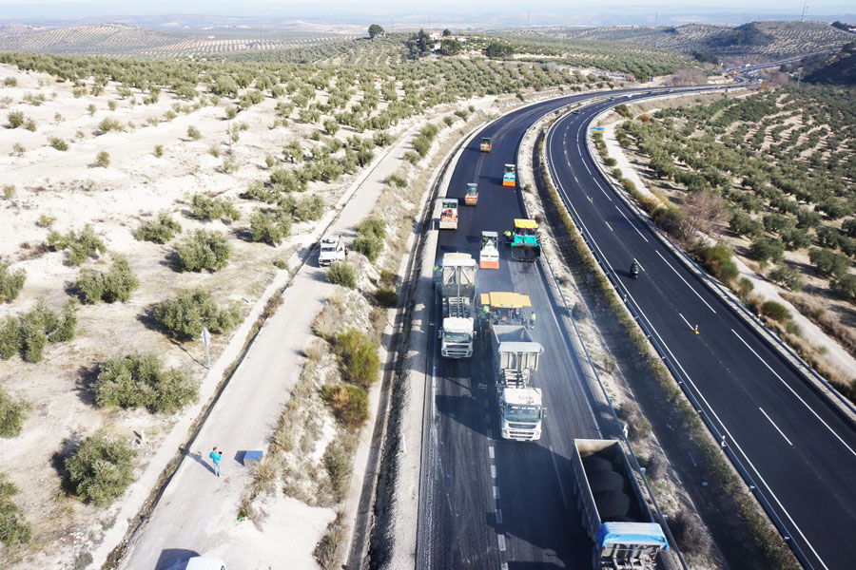
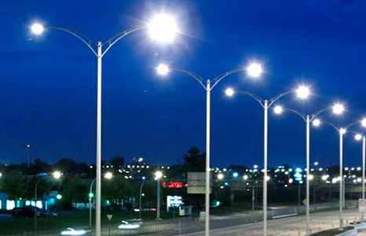
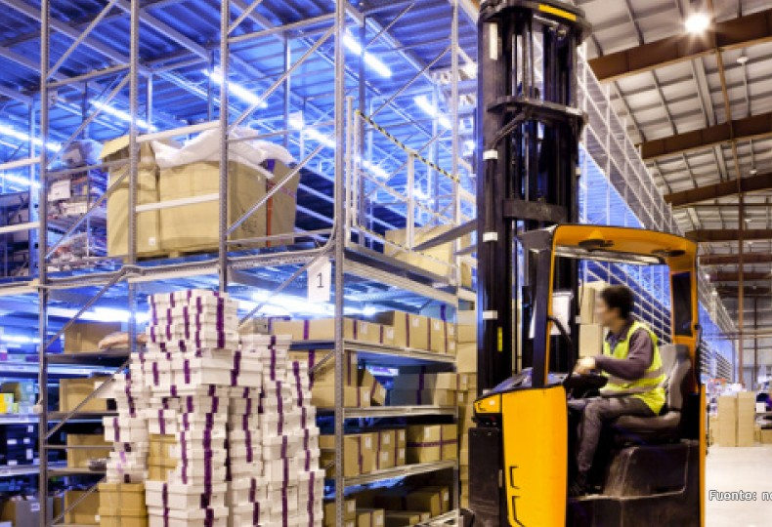
APLICACIONES
Este algoritmo puede ser utilizado para:
La distribución de productos de una empresa a diferentes destinos utilizando diferentes medios de transporte.
La red de alumbrado público.
Sistema de vías públicas.

Slide 13
GRACIAS

